Slide 1
Where do you want to live?

Slide 2


Slide 3
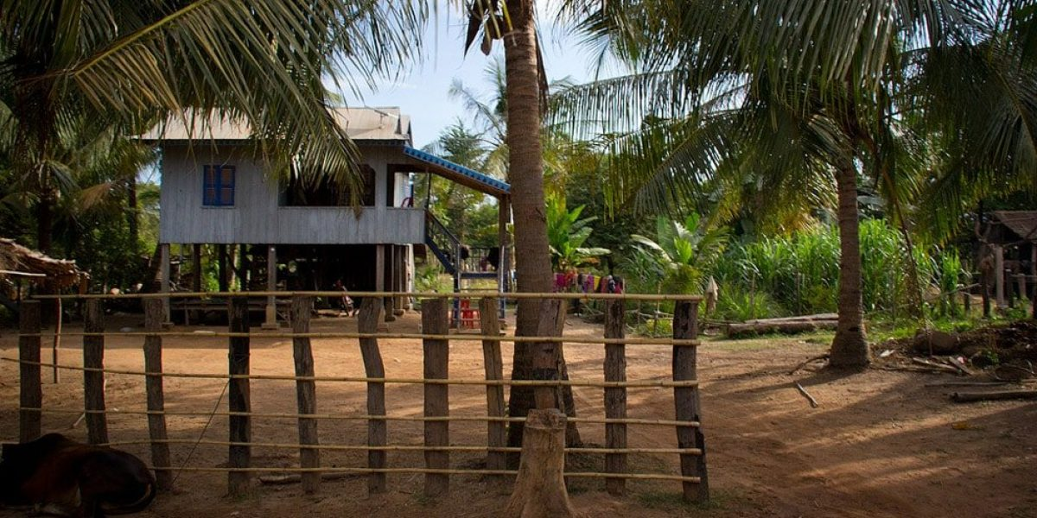

Slide 4


Slide 5
Where to live
City or Rural area
Weather
Activities or Hobbies
Health, school

Slide 6
Questions
Where do you want to live?
Who do you want to live with?
How is the weather at there?
What type of activities or hobbies do you enjoy?
Are there a lot of hospitals or schools around that area?
Why are you interested in that place?
What is special about a place you choose?

